Slide 1

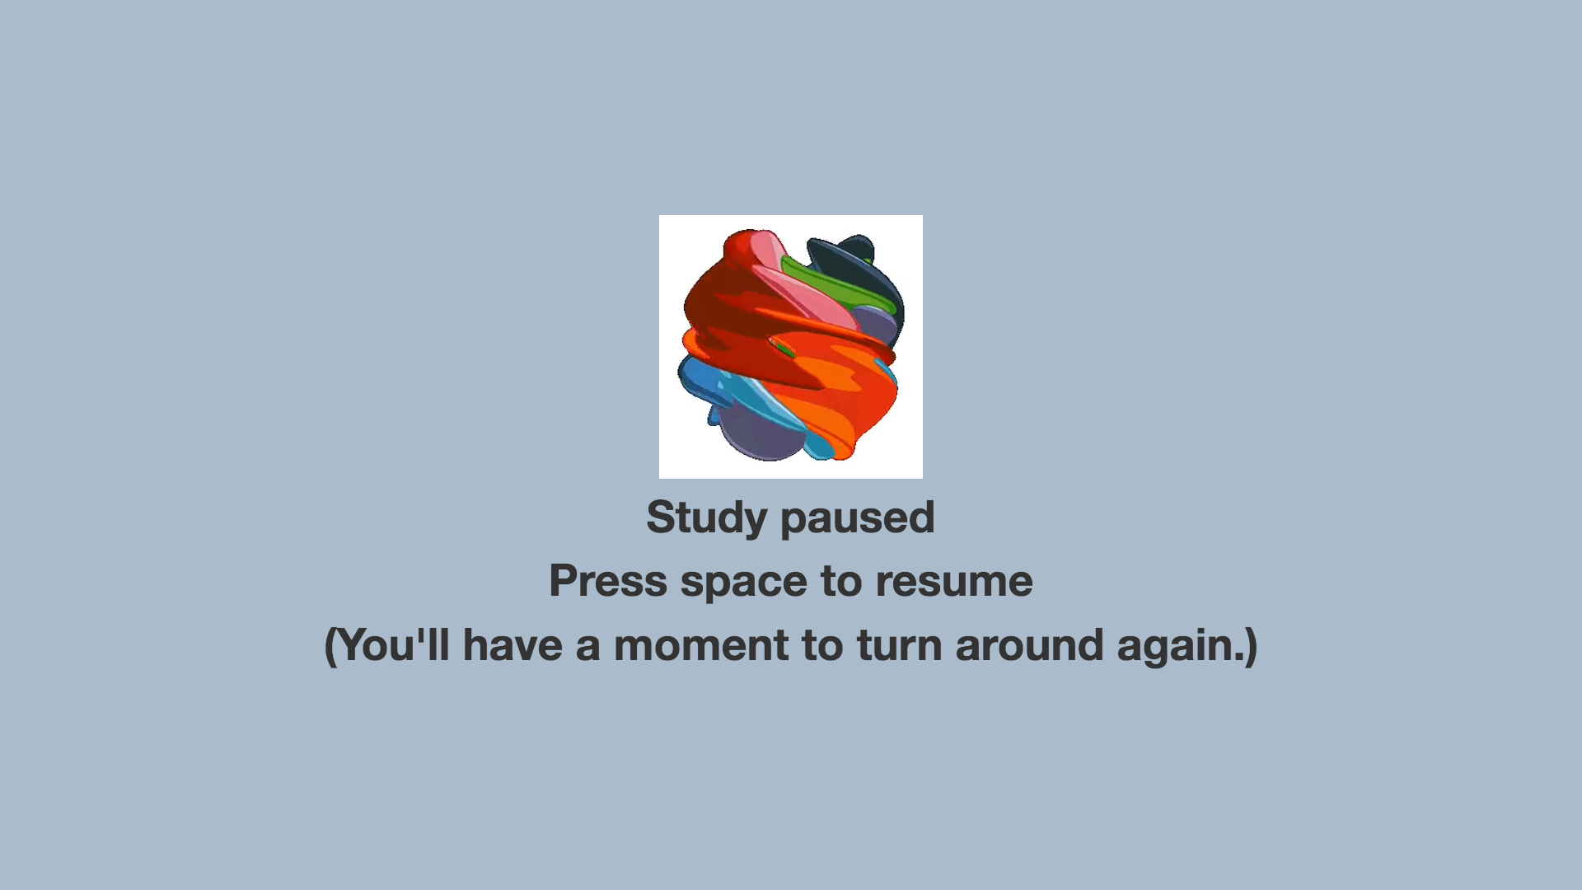
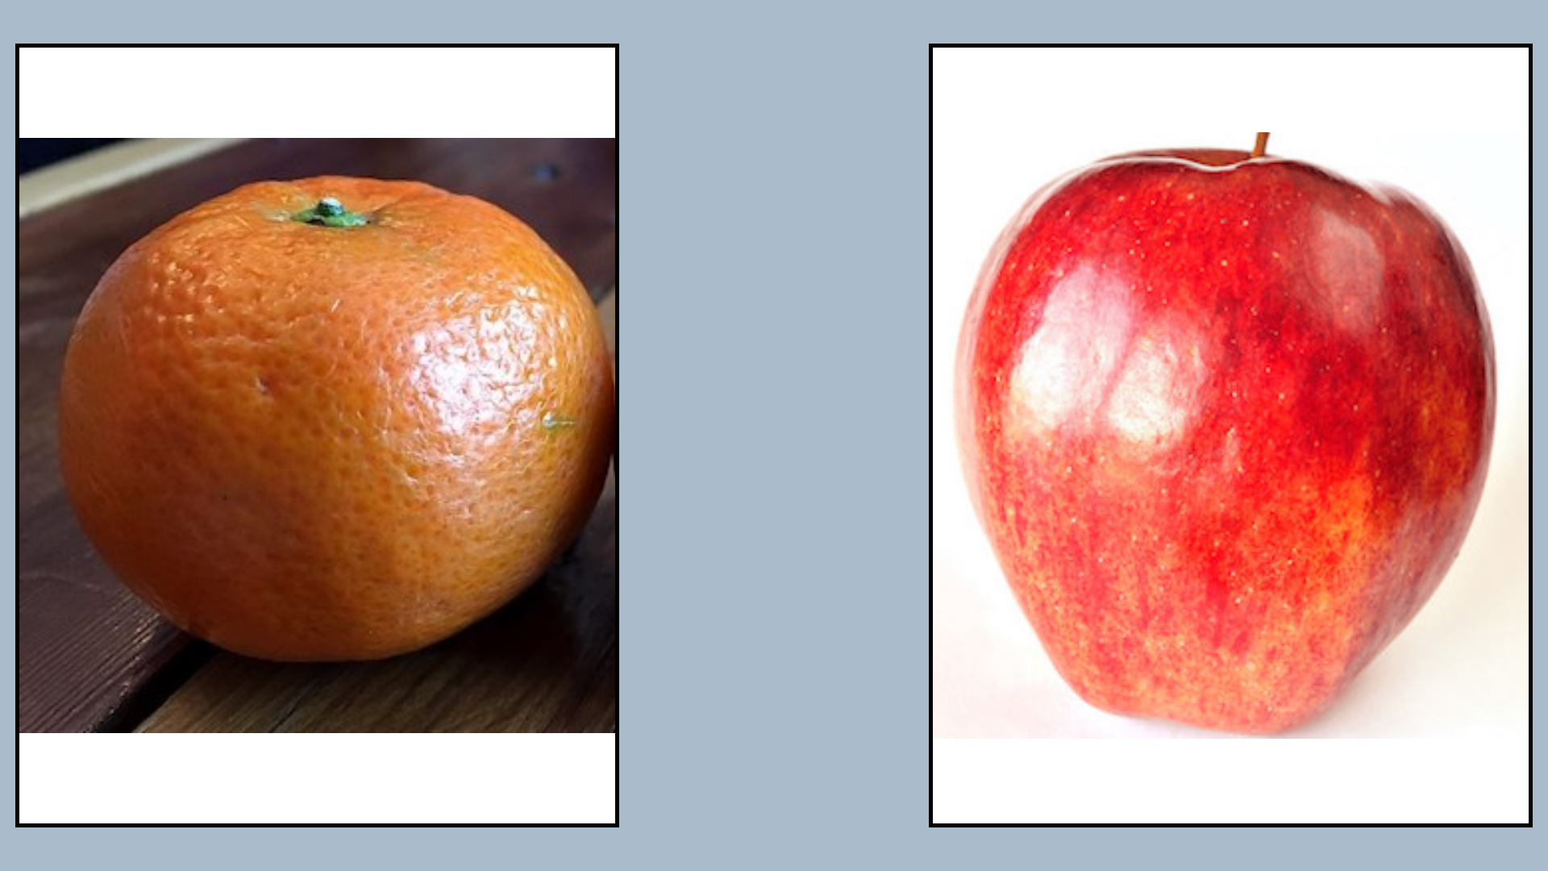

♫ audioSources
♫ pauseAudio
Announcement phase (optional)
Duration: maximum of
attnLength, audio duration
containerColor
backgroundColor
x N (determined
by trial length)
Duration: trialLength seconds
displayMs
♫ musicSources
Alternates between leftImagesA and leftImagesB
blankMs
Alternates between rightImagesA and rightImagesB
♫ endAudioSources
Wrap-up audio (optional) – useful if this is last trial

Slide 2
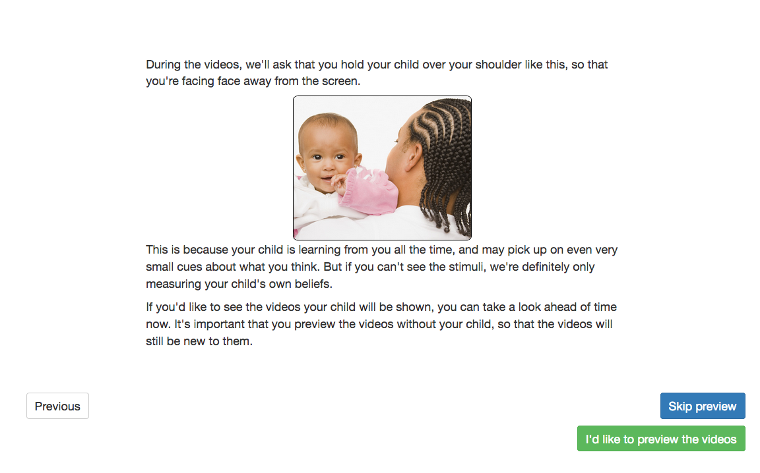
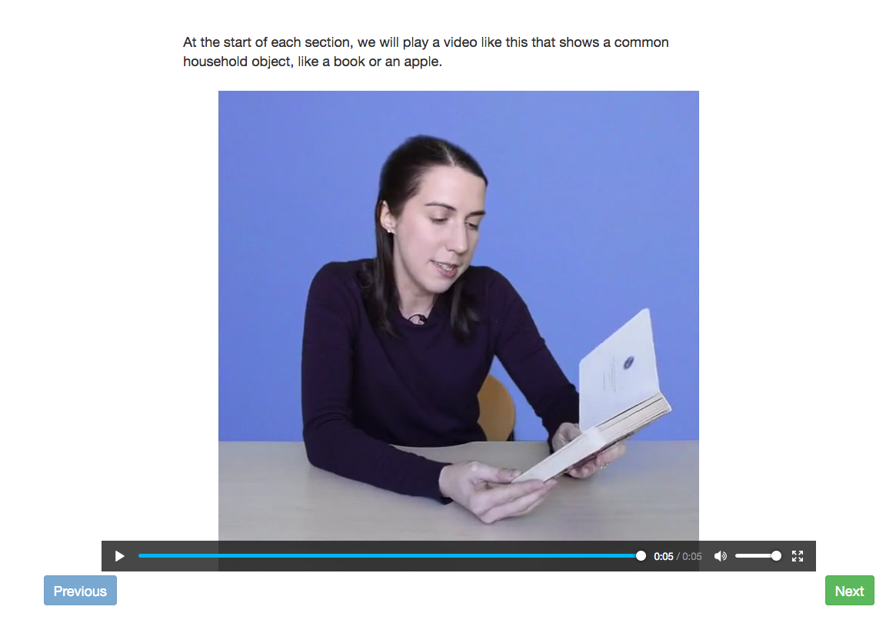
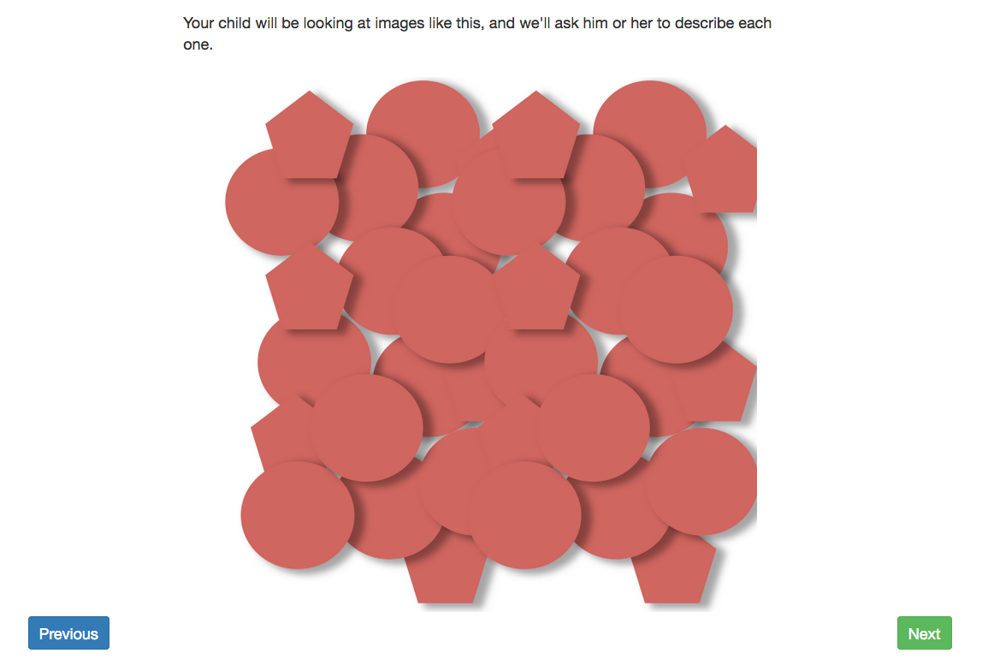
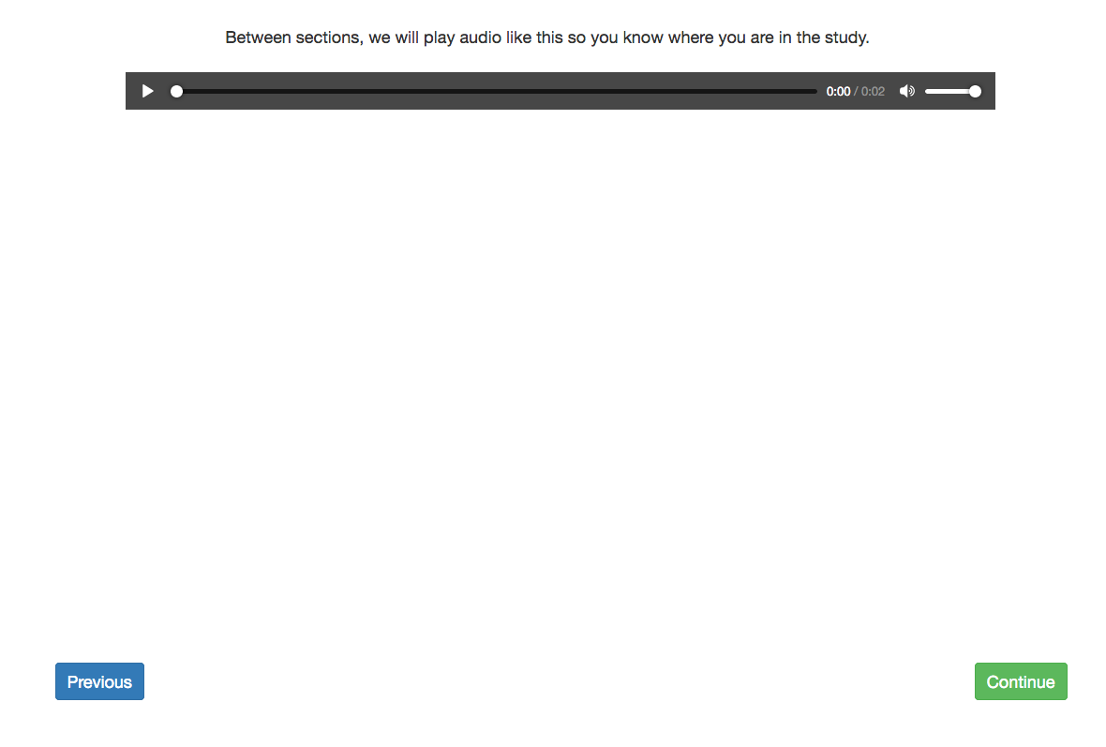

Slide 3
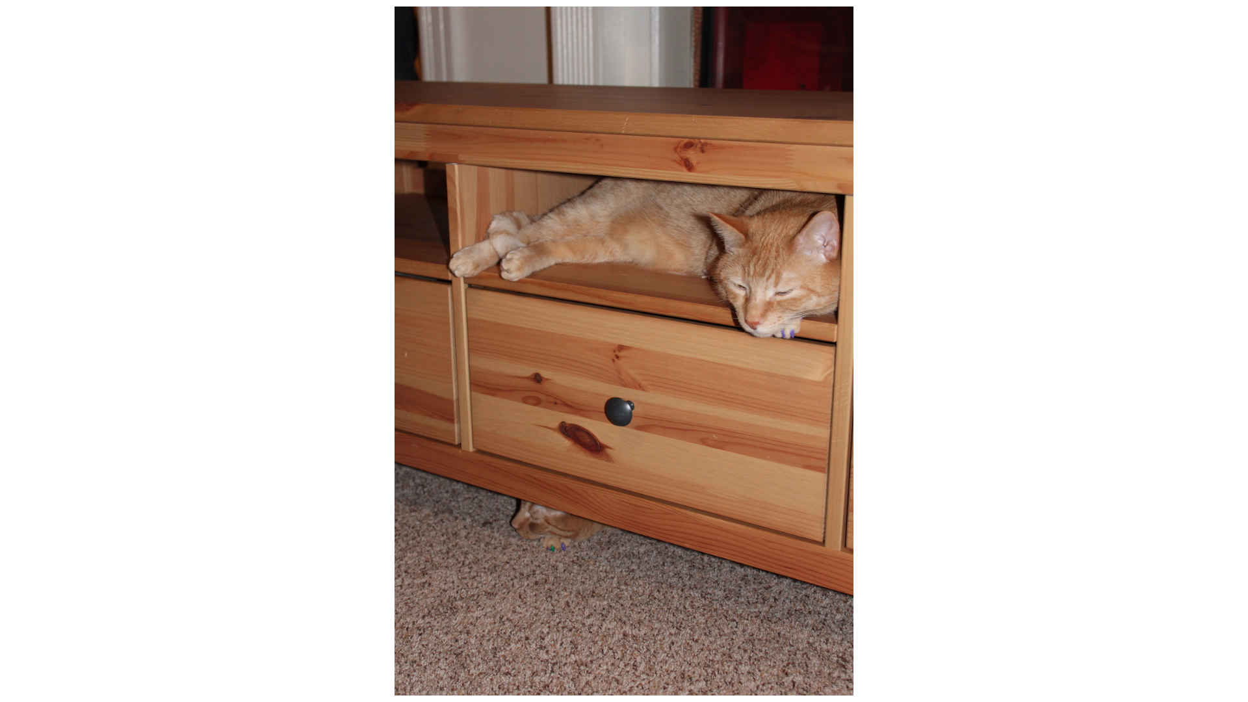
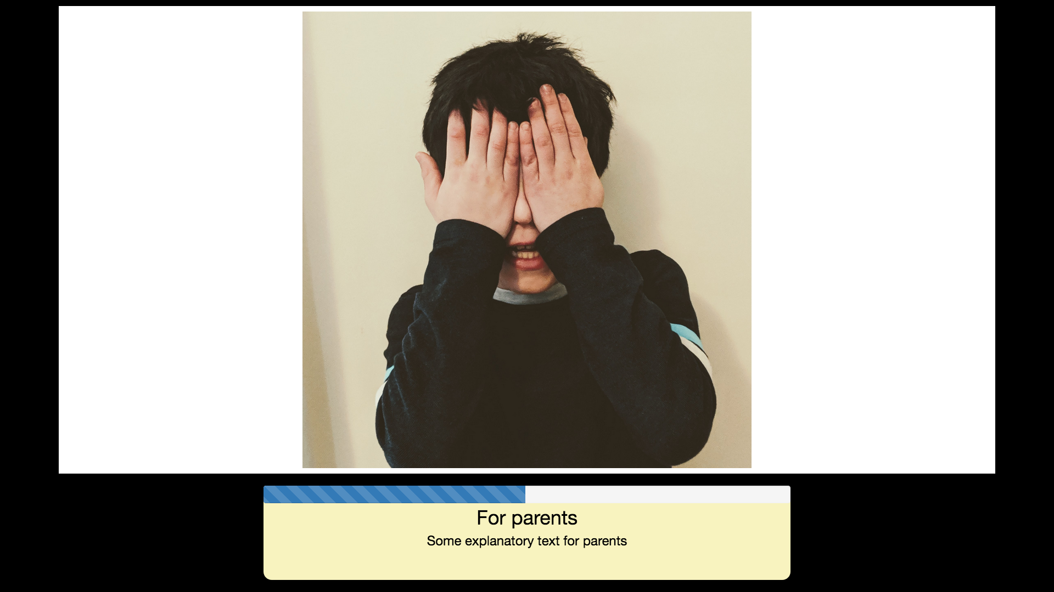
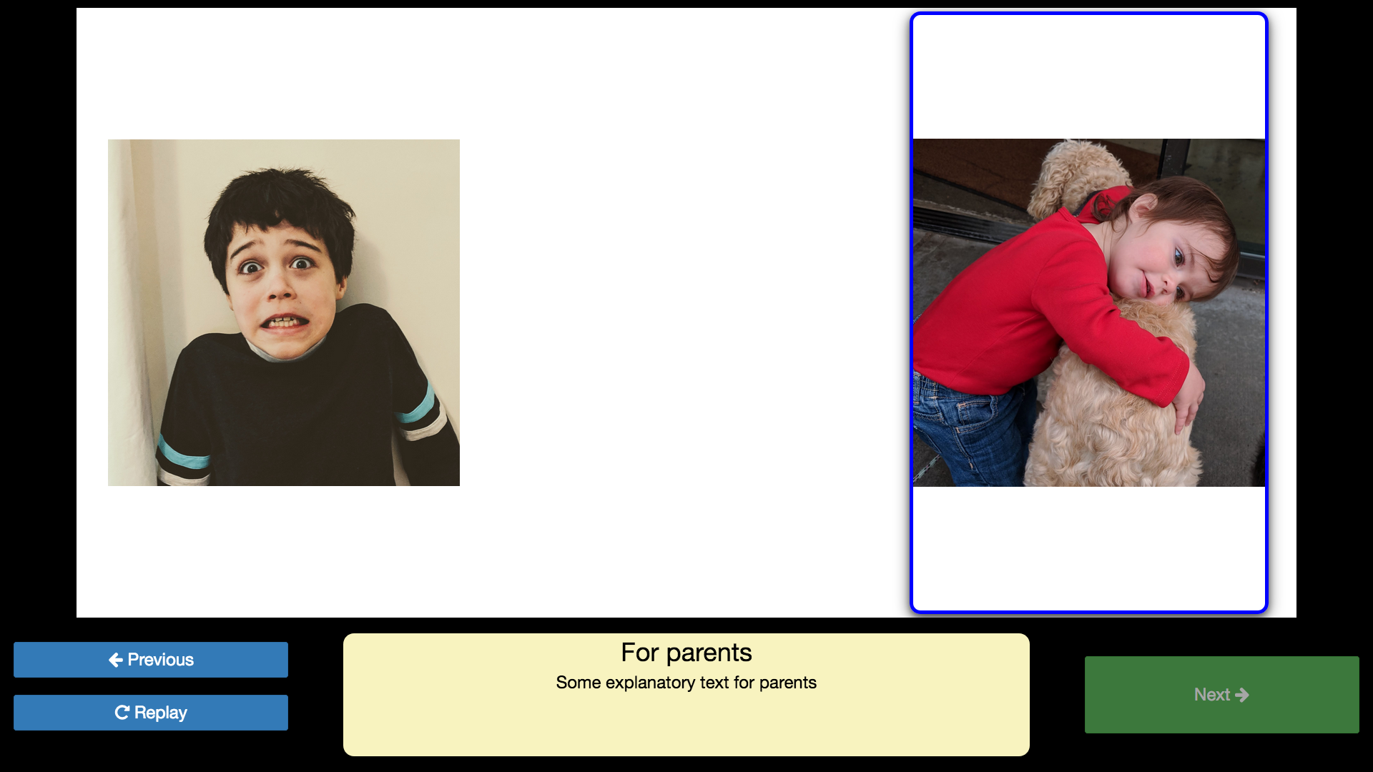
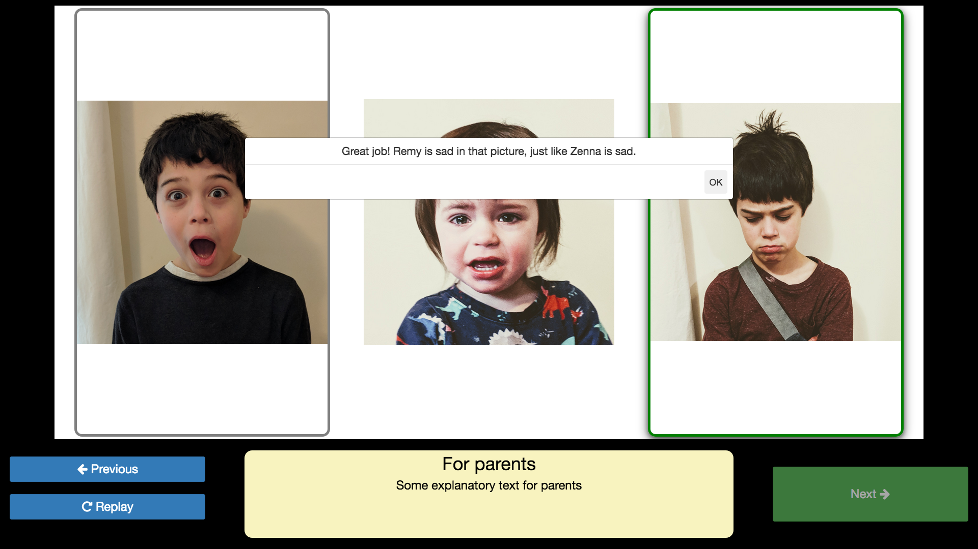
Show image(s) for a set
duration with “maximizeDisplay”: true
Display a progress bar
Highlight images at specified times
during audio
Ask children to click one of the images,
and provide feedback (audio and/or text)
on answers

Slide 4


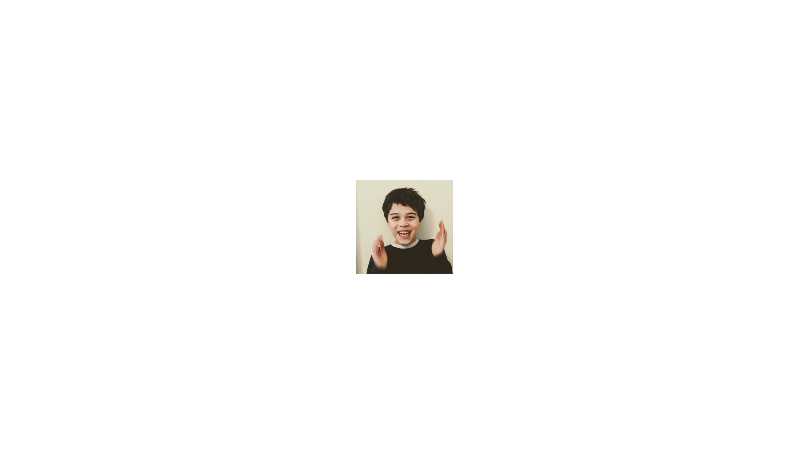

backgroundColor
Wait for video recording to start (if applicable)
20% of screen width
(“left” placement)
calibrationLength
♫ calibrationAudio
(order and number determined by calibrationPositions)
50% of screen width
(“center” placement)
calibrationLength
♫ calibrationAudio
20% of screen width
(“right” placement)
calibrationLength
♫ calibrationAudio
calibrationVideo
or calibrationImage

